Slide 1

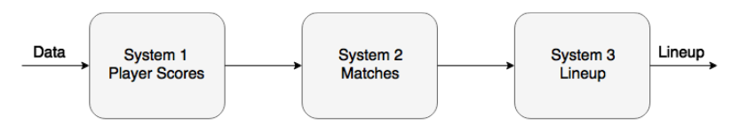
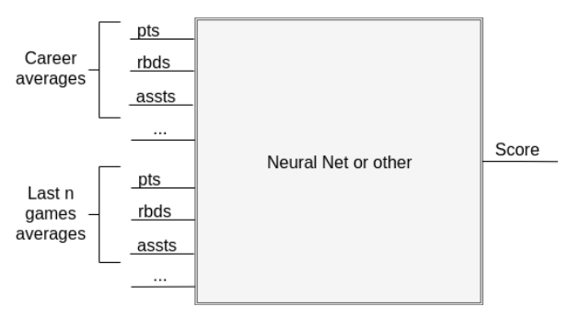
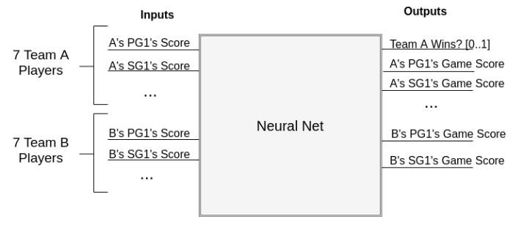
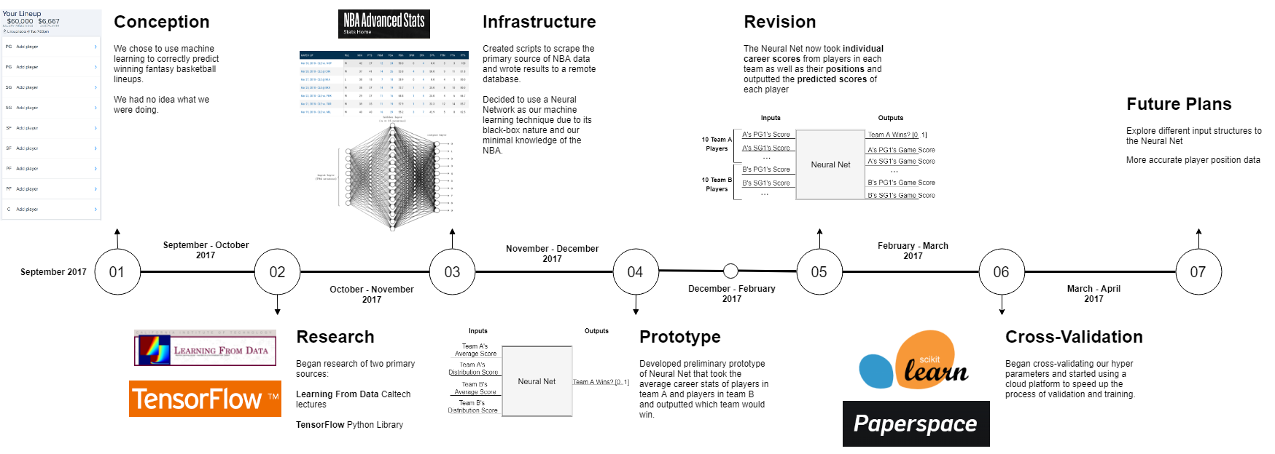
PICKING WINNERS FOR FANTASY BASKETBALL WITH MACHINE LEARNING
Date: April 5th 2018
ECSE 457 Design Project
Group 23
1
3
Objective
Architecture
2
Background
4
Results
5
Timeline
6
Future Plans

